Slide 1
Employee Data Analysis using Excel
STUDENT NAME: MOHAN RAM.T REGISTER NO: 312214244
NAAN MUDHALVAN ID: 6B9FDD544E3B77A91264EBCD9E7257FF DEPARTMENT: B COM (ACCOUNTING AND FINANCE) COLLEGE: ST. THOMAS COLLEGE OF ARTS AND SCIENCES

Slide 2
PROJECT TITLE
Employee Data Analysis using Excel - Salaries

Slide 3


AGENDA
Problem Statement
Project Overview
End Users
Our Solution and Proposition
Dataset Description
Modelling Approach
Results and Discussion
Conclusion
3/21/2024 Annual Review

Slide 4

PROBLEM STATEMENT
An effective employee salary database management system is crucial for payroll.
It's a payroll tool that decides how a company will handle
everything from collecting
employee data to filing reports required by law. The salary management system is an efficient instrument for maintaining the payroll system's perfection.
4

Slide 5

PROJECT OVERVIEW
An employee database
•c.ontains critical information, such as each employee's personal information, as well as company-related information such as their pay scale, hire date, and more. It holds a variety of employee personnel fields such as name, age, job title, salary, length of service, etc for an HR to refer from.
5

Slide 6

WHO ARE THE END USERS?
An employee database can be used by human resources staff to track employee data, and it can also be used by the organization's accounting staff to track payroll data.

Slide 7

OUR SOLUTION AND ITS VALUE PROPOSITION
An employee value proposition (EVP) is a statement that outlines the benefits an employee can expect to receive from working for a company. The EVP includes salary, benefits, and other rewards that employees receive in exchange for their contributions to the company.

Slide 8
Dataset Description
Salary represents a fixed and predetermined remuneration granted by an employer to an employee in exchange for their provided services or work. Typically stated as an annual sum, salaries are often distributed at regular intervals, such as monthly or bi-weekly.

Slide 9

THE "WOW" IN OUR SOLUTION
The salary structure typically includes basic salary, allowances, and other indirect components.
Gross salary is the sum of all components. Net salary is the amount received after tax deductions. CTC includes all indirect
benefits and components such as basic salary, PF, gratuity, and
allowances.
3/21/2024 Annual Review
9

Slide 10
MODELLING
A payroll management system describes the specialist software that can empower companies by streamlining and automatically carrying out the processes involved in payroll such as working out take home pay and taxes – saving time for the employer and reducing the number of errors.

Slide 11
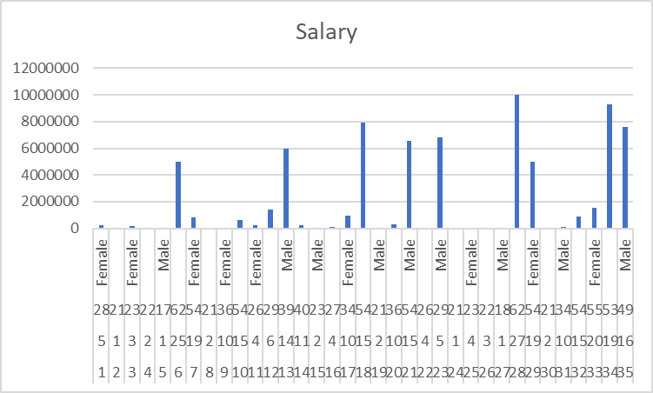
RESULTS

Slide 12
conclusion
An employee salary database is important for organizations to ensure they pay employees correctly and comply with regulations. It can also help improve personnel management and protect employers from fraud claims.

